Slide 1
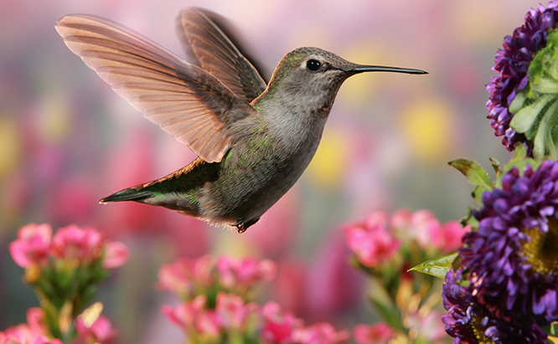
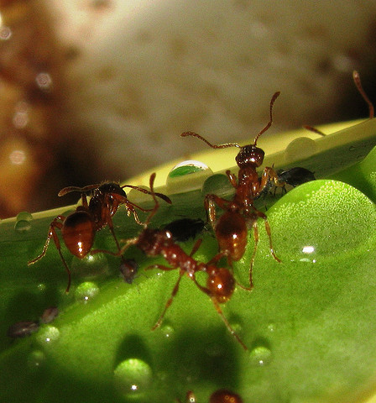
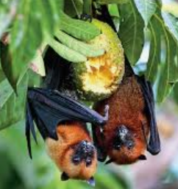
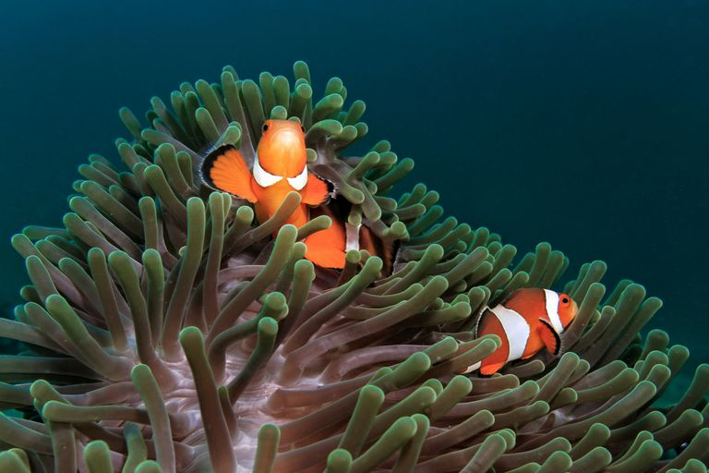
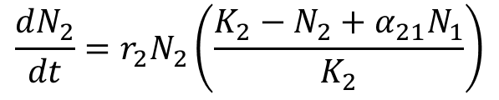
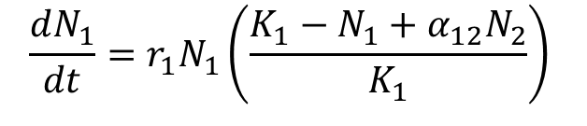
Mutualism
a reciprocally positive interaction between species (Bronstein 2009)
$$\frac{dN_{1}}{dt}=r_{1}N_{1}\left(\frac{K_{1}−N_{1}+α_{12}N_{2}}{K_{1}}\right)$$
$$\frac{dN_{2}}{dt}=r_{2}N_{2}\left(\frac{K_{2}−N_{2}+α_{21}N_{1}}{K_{2}}\right)$$

Slide 2
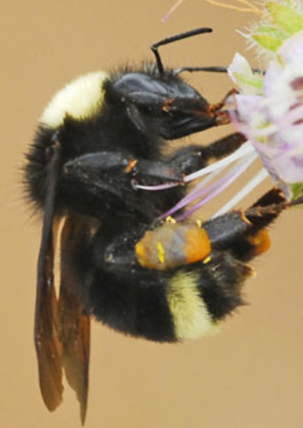
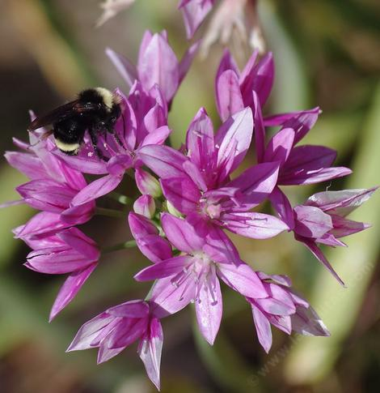
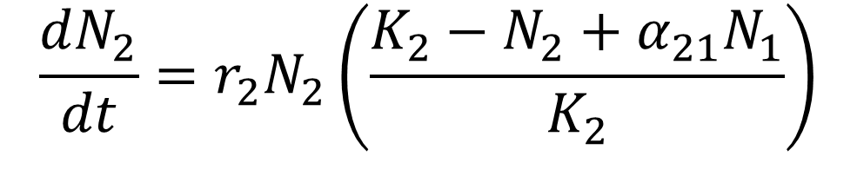
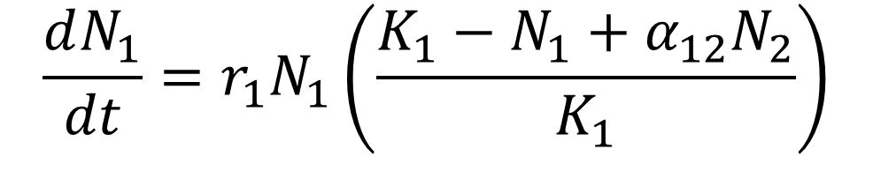
Lotka-Volterra model of mutualism
$$\frac{dN_{1}}{dt}=r_{1}N_{1}\left(\frac{K_{1}−N_{1}+α_{12}N_{2}}{K_{1}}\right)$$
$$\frac{dN_{2}}{dt}=r_{2}N_{2}\left(\frac{K_{2}−N_{2}+α_{21}N_{1}}{K_{2}}\right)$$
Gause and Witt (1935)
Vandermeer & Boucher (1976)

Slide 3
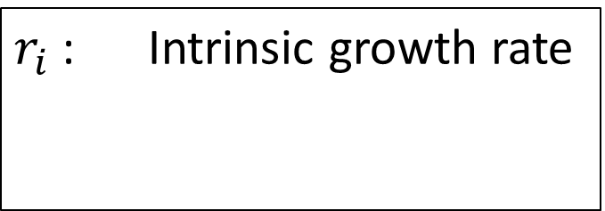
Lotka-Volterra model of mutualism
$$\frac{dN_{1}}{dt}=r_{1}N_{1}\left(\frac{K_{1}−N_{1}+α_{12}N_{2}}{K_{1}}\right)$$
$$\frac{dN_{2}}{dt}=r_{2}N_{2}\left(\frac{K_{2}−N_{2}+α_{21}N_{1}}{K_{2}}\right)$$
$r_{i}$ : Intrinsic growth rate
Gause and Witt (1935)
Vandermeer & Boucher (1978)

Slide 4
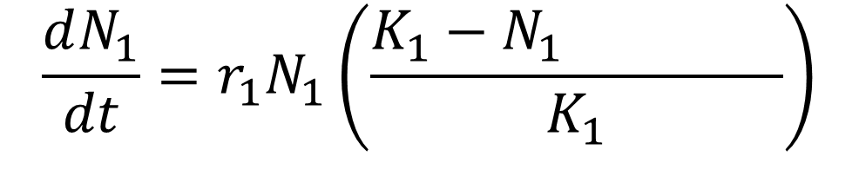
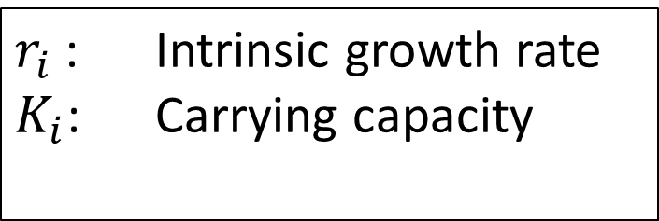
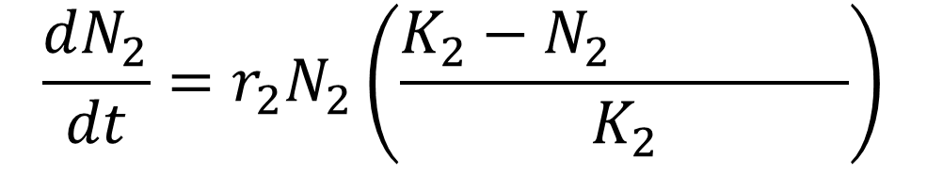
Lotka-Volterra model of mutualism
Self-regulation
Self-regulation
N₁
$$\frac{dN_{1}}{dt}=r_{1}N_{1}\left(\frac{K_{1}−N_{1}∓α_{12}N_{2}}{K_{1}}\right)$$
$$\frac{dN_{2}}{dt}=r_{2}N_{2}\left(\frac{K_{2}−N_{2}+α_{21}N_{1}}{K_{2}}\right)$$
N₂
$r_{i}$ : Intrinsic growth rate
$K_{i}$: Carrying capacity
Gause and Witt (1935)
Vandermeer & Boucher (1978)

Slide 5
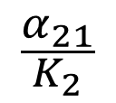
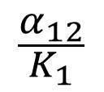
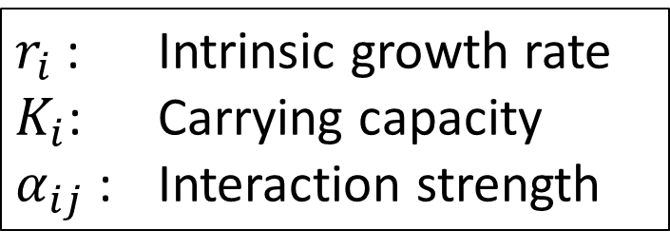
Lotka-Volterra model of mutualism
Self-regulation
N₁
$$\frac{dN_{1}}{dt}=r_{1}N_{1}\left(\frac{K_{1}−N_{1}+α_{12}N_{2}}{K_{1}}\right)$$
$$\frac{α_{12}}{K_{1}}$$
$$\frac{α_{21}}{K_{2}}$$
$$\frac{dN_{2}}{dt}=r_{2}N_{2}\left(\frac{K_{2}−N_{2}+α_{21}N_{1}}{K_{2}}\right)$$
N₂
$r_{i}$ : Intrinsic growth rate
$K_{i}$: Carrying capacity
$α_{ij}$ : Interaction strength
Gause and Witt (1935)
Vandermeer & Boucher (1978)

Slide 6
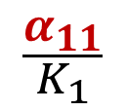
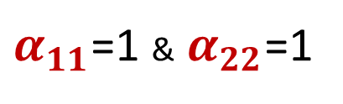
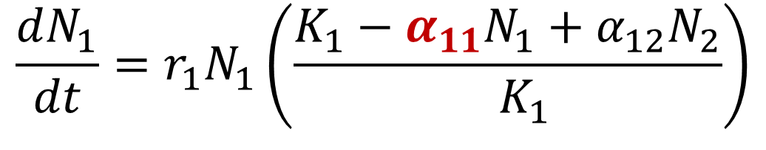
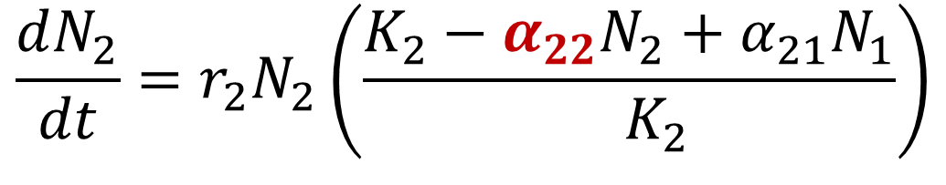
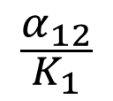
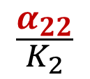
Lotka-Volterra model of mutualism
Self-regulation
$$\frac{α_{11}}{K_{1}}$$
N₁
$$\frac{dN_{1}}{dt}=r_{1}N_{1}\left(\frac{K_{1}−α_{11}N_{1}+α_{12}N_{2}}{{ K}_{1}}\right)$$
$$\frac{α_{12}}{K_{1}}$$
$$\frac{α_{21}}{K_{2}}$$
$$\frac{dN_{2}}{dt}=r_{2}N_{2}\left(\frac{K_{2}−α_{22}N_{2}+α_{21}N_{1}}{{ K}_{2}}\right)$$
N₂
$$\frac{α_{22}}{K_{2}}$$
$r_{i}$ : Intrinsic growth rate
$K_{i}$: Carrying capacity
$α_{ij}$ : Interaction strength
To express interspecific competition with respect of intraspecific competition, we standardize by assuming:
$α_{11}$=1 & $α_{22}$=1

Slide 7
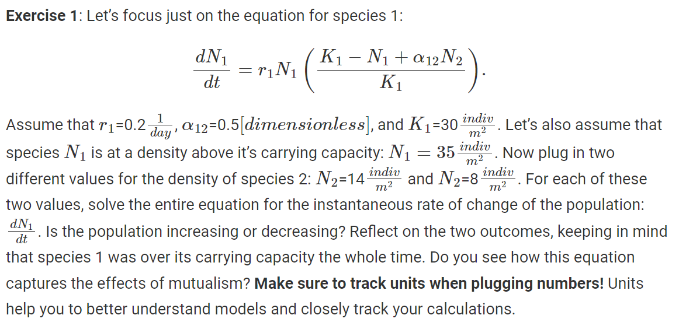
Let’s make sure we understand the equations
Exercise 3:
Potential vs realized vs mutualistic niche?

Slide 8
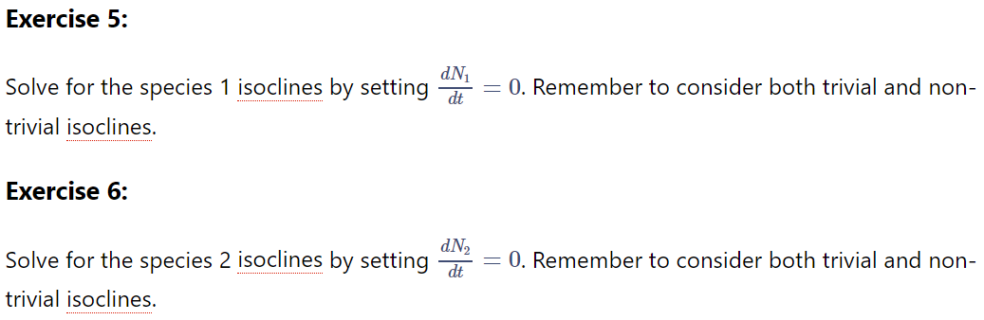
Isoclines
Provide graphical understanding of model dynamic behavior. Define when the population is neither growing nor declining.

Slide 9
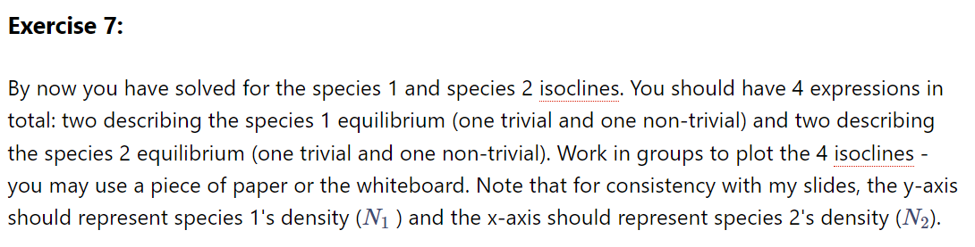
Isoclines
Provide graphical understanding of model dynamic behavior. Define when the population is neither growing nor declining.

Slide 10
Lotka-Volterra model of mutualism
Self-regulation
N₁
$$\frac{dN_{1}}{dt}=r_{1}N_{1}\left(\frac{K_{1}−N_{1}+α_{12}N_{2}}{K_{1}}\right)$$
$$\frac{α_{12}}{K_{1}}$$
$$\frac{α_{21}}{K_{2}}$$
$$\frac{dN_{2}}{dt}=r_{2}N_{2}\left(\frac{K_{2}−N_{2}+α_{21}N_{1}}{K_{2}}\right)$$
N₂
$r_{i}$ : Intrinsic growth rate
$K_{i}$: Carrying capacity
$α_{ij}$ : Interaction strength
Gause and Witt (1935)
Vandermeer & Boucher (1976)

Slide 11
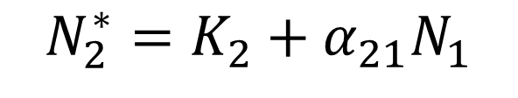
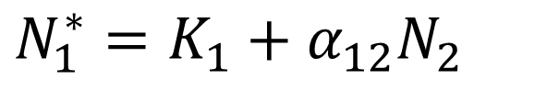
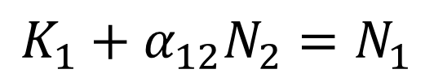
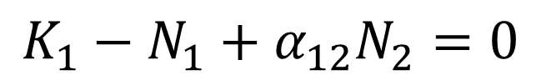
Isoclines of the L-V model of mutualism
Isoclines:
$$K_{1}−N_{1}+α_{12}N_{2}=0$$
$$K_{1}+α_{12}N_{2}=N_{1}$$
$N_{1}^{∗}=K_{1}+α_{12}N_{2}$
$$N_{2}^{∗}=K_{2}+α_{21}N_{1}$$
Gause and Witt (1935)
Vandermeer & Boucher (1976)

Slide 12
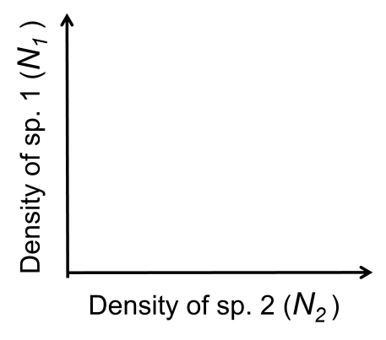
Isoclines

Slide 13
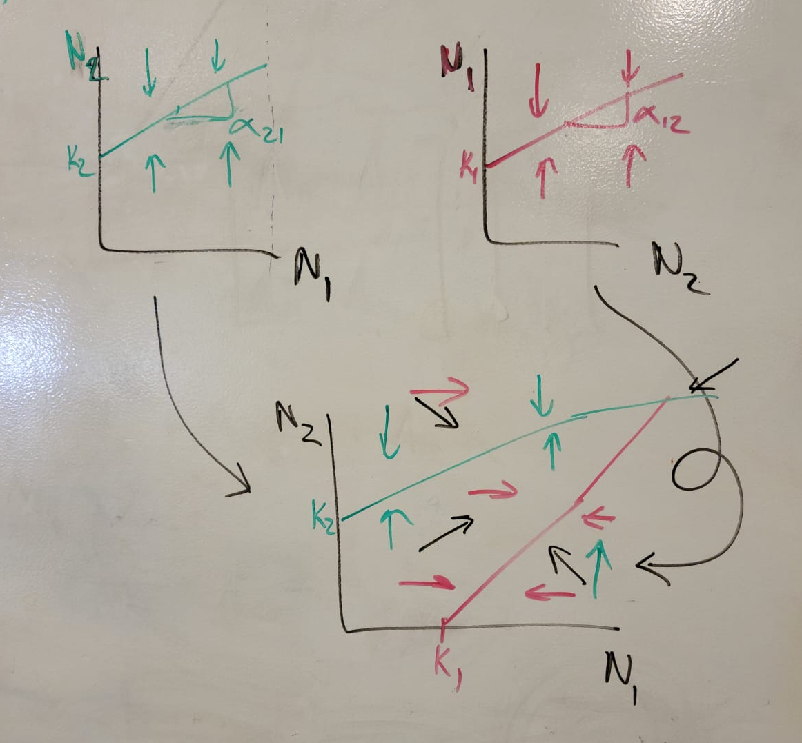

Slide 14
Effect of parameters on isoclines
Much of ecological theory can be derived from isoclines and how they change with parameter values.
Increasing or decreasing parameter values can represent biological processes of interest, and the isoclines can tell us how those processes affect system dynamics.
The ecological theory we obtain from the Lotka-Volterra model of mutualism, helps us understand the dynamic implications of important attributes such as mutualism strength and whether the interaction is facultative or obligate to each mutualistic partner.
Much of this dynamic behavior is common to many models of mutualism.

Slide 15
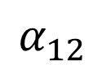
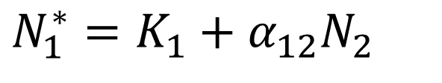
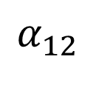
Isoclines of the L-V model of mutualism
Mutualism strength
$N_{1}^{∗}=K_{1}+α_{12}N_{2}$
Stronger mutualism
dN₁/dt=0
$$α_{12}$$
N₁ = 25
Density of sp. 1 (N₁ )
$$α_{12}$$
N₁ = 15
K₁
N₂ = 10
Gause and Witt (1935)
Vandermeer & Boucher (1976)
Density of sp. 2 (N₂ )

Slide 16
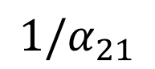
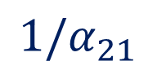
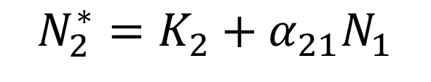
Isoclines of the L-V model of mutualism
dN₂/dt=0
$${1/α}_{21}$$
Stronger mutualism
$${1/α}_{21}$$
Density of sp. 1 (N₁ )
N₁ = 15
$$N_{2}^{∗}=K_{2}+α_{21}N_{1}$$
K₂
N₂ = 10
N₂ = 20
Gause and Witt (1935)
Vandermeer & Boucher (1976)
Density of sp. 2 (N₂ )

Slide 17
Isoclines of the L-V model of mutualism
Understand the effect of mutualism strength on the system’s dynamics
Exercise 9: Discuss with your group how you expect the strength of mutualism to affect the coexistence between species. The stability of such coexistence? Do you expect that strong or weak mutualism will allow the persistence of both species? Draw the isoclines for each scenario (weak vs. strong).

Slide 18
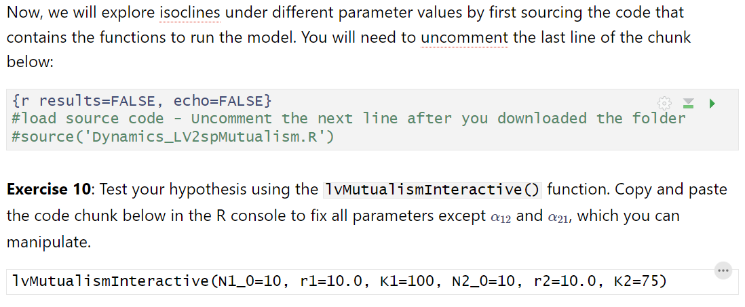
Isoclines of the L-V model of mutualism
Understand the effect of mutualism strength on the system’s dynamics

Slide 19
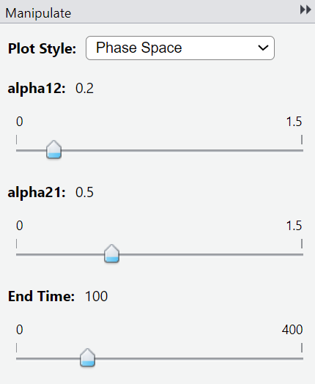
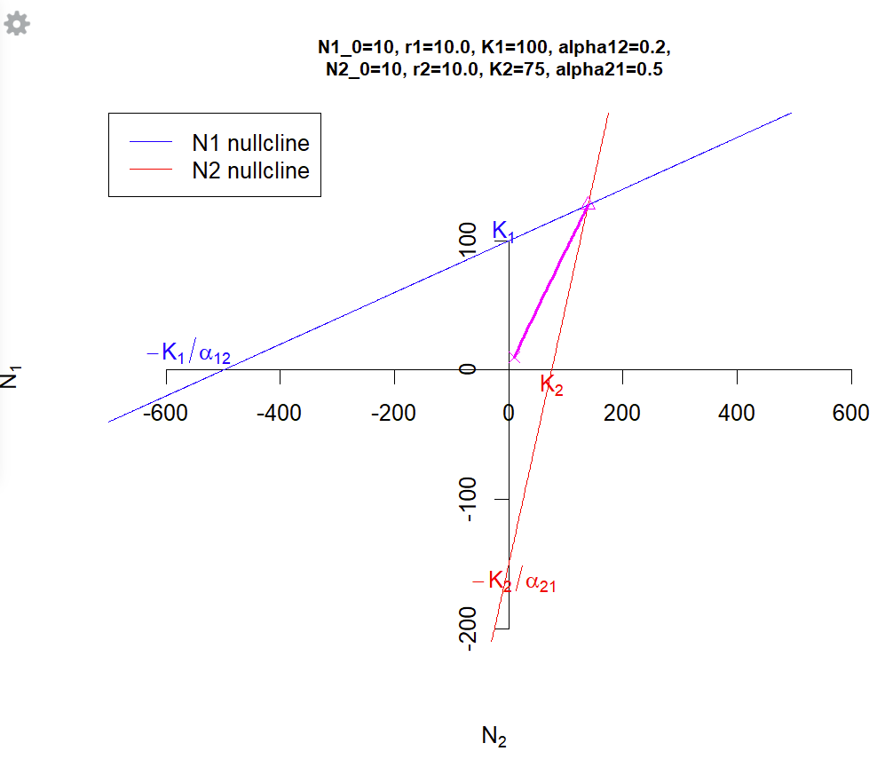

Slide 20
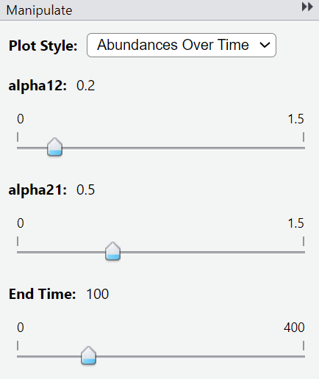
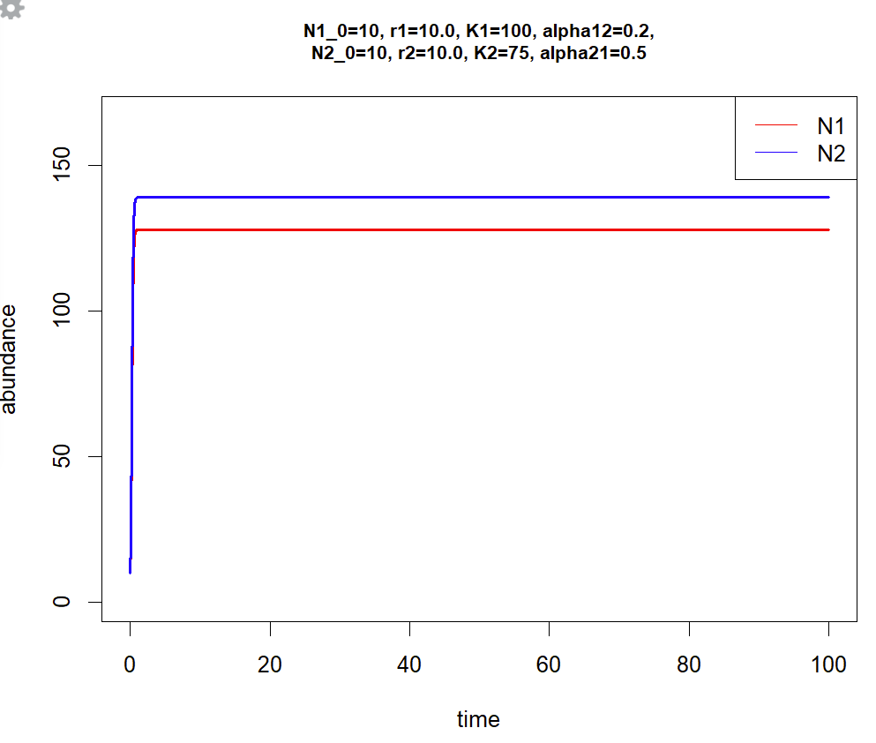

Slide 21
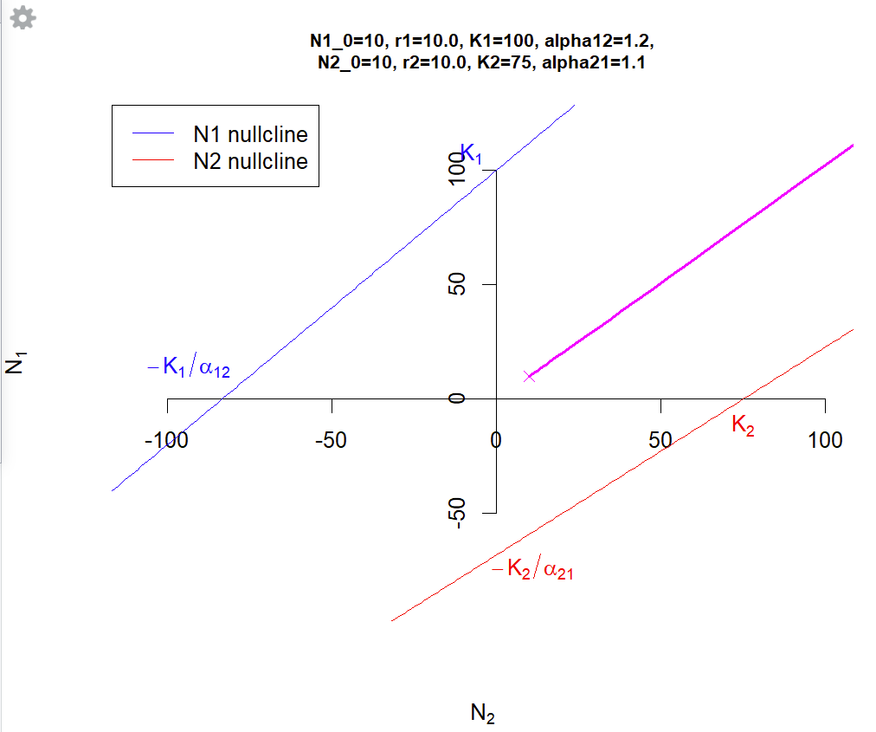

Slide 22
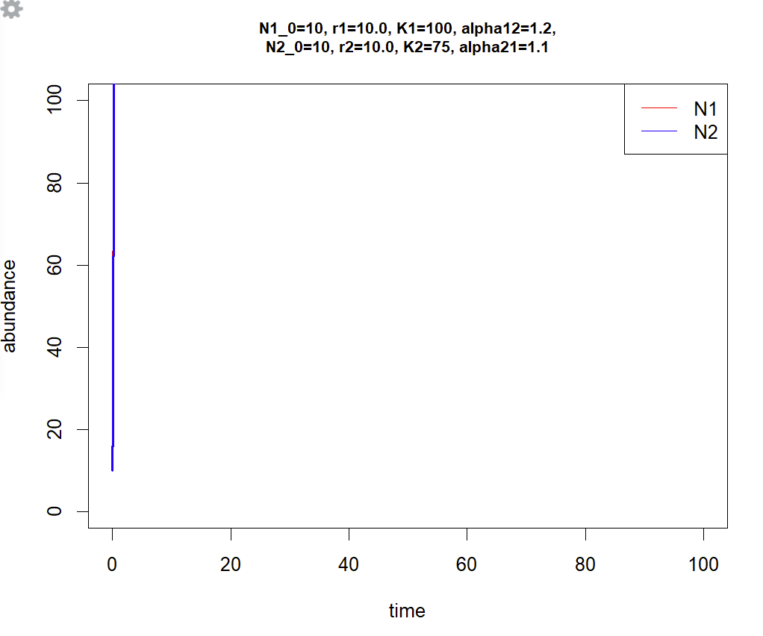

Slide 23
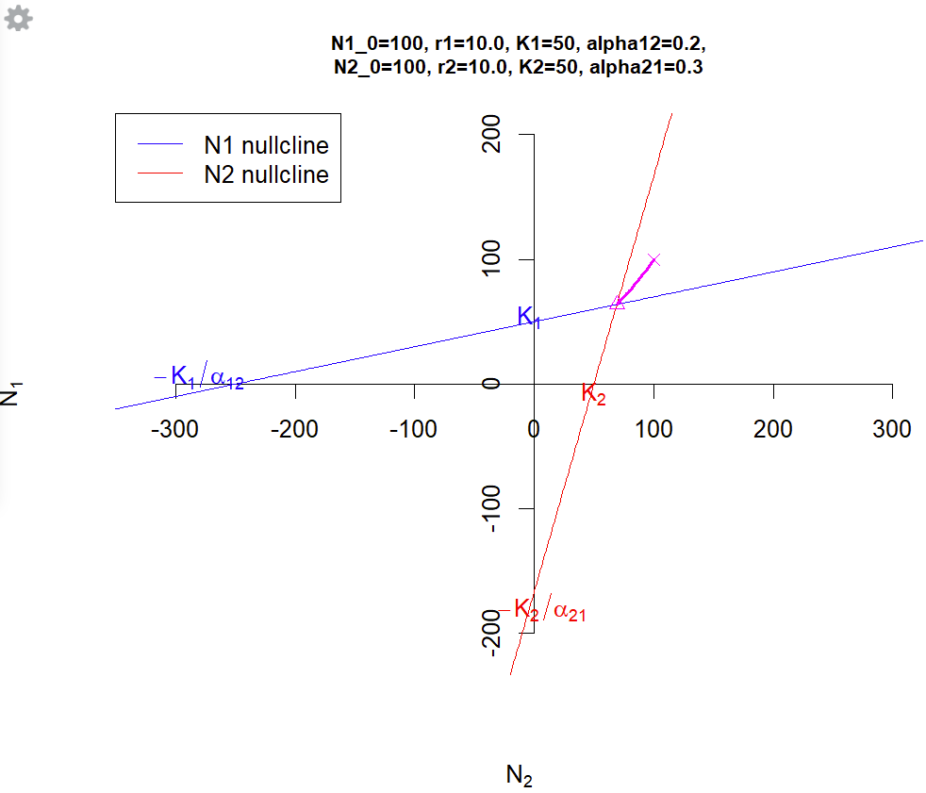

Slide 24
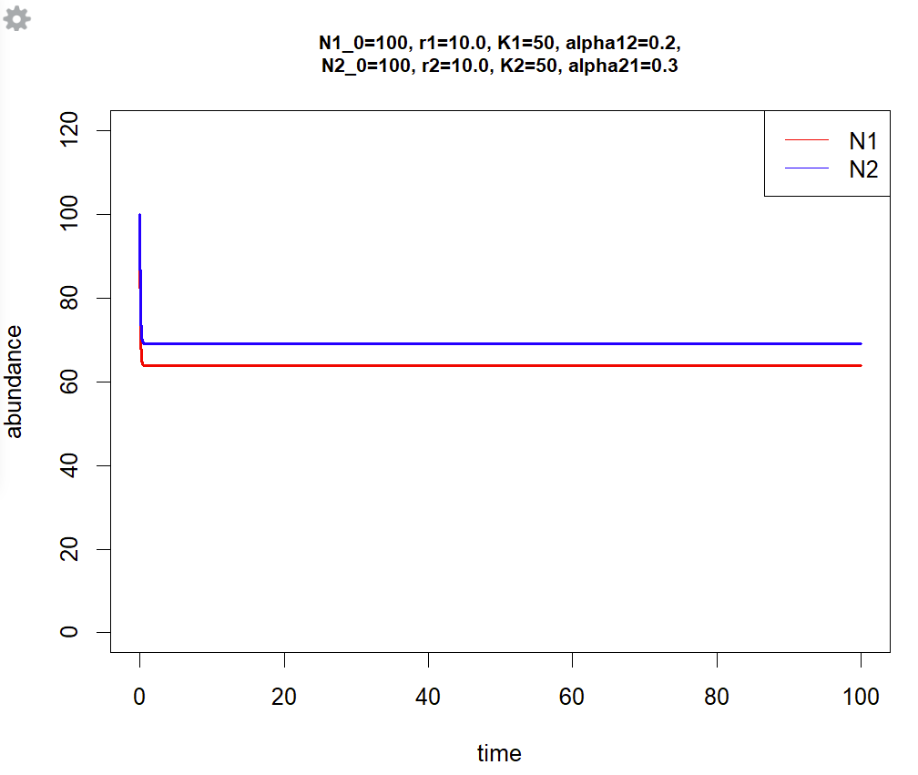

Slide 25
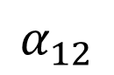
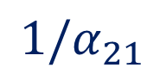
Isoclines of the L-V model of mutualism
Weak mutualisms
dN₂/dt=0
$${1/α}_{21}$$
dN₁/dt=0
$$α_{12}$$
Density of sp. 1 (N₁ )
K₁
K₂
Gause and Witt (1935)
Vandermeer & Boucher (1976)
Density of sp. 2 (N₂ )

Slide 26
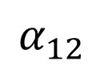

Isoclines of the L-V model of mutualism
Strong mutualisms
dN₁/dt=0
Positive feedbacks produce:
“the orgy of mutualisms”
May (1984)
$$α_{12}$$
Density of sp. 1 (N₁ )
dN₂/dt=0
$${1/α}_{21}$$
K₁
K₂
Gause and Witt (1935)
Vandermeer & Boucher (1976)
Density of sp. 2 (N₂ )

Slide 27
Isoclines of the L-V model of mutualism
Facultative/Obligate
$N_{1}^{∗}=K_{1}+α_{12}N_{2}$
facultative
obligate
Density of sp. 1 (N₁ )
K₁
K₁
Gause and Witt (1935)
Vandermeer & Boucher (1976)
Density of sp. 2 (N₂ )

Slide 28
Isoclines of the L-V model of mutualism
Understand the effect of mutualism obligacy on the system’s dynamics
Exercise 11: Discuss with your group how you expect facultative vs obligate mutualism will affect the stable coexistence (i.e., persistence of both species at plausible abundances) of the model. Which do you think is more likely to facilitate stable coexistence? Draw the isoclines for each case.

Slide 30
Adding saturating benefits
L-V model assumes mutualistic benefits increase linearly with the abundance of mutualistic partners.
Causes the positive feedback loop that drives the abundance of the populations to infinity.
Benefits saturate (e.g., fixed number of ovules per plant, consumption saturation).
Saturation as Holling type II functional response.
Exercise 13: Sketch a diagram approximating how isoclines of the L-V model might change with saturation of benefit accrual between both mutualists.

Slide 31



Lotka-Volterra model of mutualism
Self-regulation
Self-regulation
N₁
$$\frac{dN_{1}}{dt}=r_{1}N_{1}\left(\frac{K_{1}−N_{1}+α_{12}N_{2}}{K_{1}}\right)$$
$$α_{12}N_{2}$$
$$α_{21}N_{1}$$
$$\frac{dN_{2}}{dt}=r_{2}N_{2}\left(\frac{K_{2}−N_{2}+α_{21}N_{1}}{K_{2}}\right)$$
N₂
$r_{i}$ : Intrinsic growth rate
$α_{ij}$ : Interaction strength
$K_{i}$: Carrying capacity
Gause and Witt (1935)
Vandermeer & Boucher (1976)

Slide 32








Lotka-Volterra model of mutualism with benefit saturation
Self-regulation
Self-regulation
$$\frac{dN_{1}}{dt}=r_{1}N_{1}\left(\frac{K_{1}−N_{1}+\frac{a_{12}N_{2}}{1+h_{1}N_{2}}}{K_{1}}\right)$$
N₁
$$\frac{a_{12}N_{2}}{1+h_{1}N_{2}}$$
$$\frac{a_{21}N_{1}}{{1+h}_{2}N_{1}}$$
$$\frac{dN_{2}}{dt}=r_{2}N_{2}\left(\frac{K_{2}−N_{2}+\frac{a_{21}N_{1}}{1+h_{2}N_{1}}}{K_{2}}\right)$$
N₂
$r_{i}$ : Intrinsic growth rate
$a_{ij}$ : “attack rate” (≠$α_{ij} alpha)$
$h_{i}$ : handling time
$K_{i}$: Carrying capacity
Interaction strengths, $α_{ij}$:
$$\frac{a_{12}}{h_{1}N_{2}}$$
,
$$\frac{a_{21}}{h_{2}N_{1}}$$
Per-capita effect of population j on an average individual of i

Slide 33


Kayla Hale
University of Michigan
Why mutualisms are understudied in Population and Community Ecology?
Technical difficulties to find stable solutions for dynamic models of mutualism (“orgy of mutual benefaction”, May 1984)
Lack of appropriate empirical and theoretical tools to develop a synthesis of the enormous diversity of mutualistic interactions (May 1976).

Slide 34
Do we have a robust ecological theory on population dynamics of 2-species mutualisms? What are the key dynamical consequences of mutualistic interactions?
Population dynamics of mutualisms are qualitatively robust across derivations, including levels of detail, types of benefit, and inspiring systems.
Stable coexistence at high density and destabilizing thresholds at low density.
These dynamics emerge when benefits saturate, whether due to intrinsic or extrinsic density dependence in intraspecific or interspecific processes, or both.
Thresholds: 1) Allee effects, 2) low, and 3) high partner density.
There is a robust population dynamic theory of 2-species mutualisms.

Slide 35
Multispecies models

Slide 36

How many lines of code and terms per equation you would need for a network of 50 plant and 100 pollinator species??
Clearly not an efficient way to code and think about the problem, plus an error-prone approach when writing manually each interaction per each equation.

Slide 37

Matrices to summations
A much more efficient approach is thinking in matrices (which encode the networks of species interactions) and connect those matrices to the summation notation in equations.
Another way to represent logistic growth
Per-capita growth rate
Bascompte et al 2006 (Science)

Slide 38

Matrices to summations
A much more efficient approach is thinking in matrices (which encode the networks of species interactions) and connect those matrices to the summation notation in equations.
Another way to represent logistic growth
Population growth rate
When is facultative or obligate?
Bascompte et al 2006 (Science)

Slide 39



Matrices to summations
Exercise 14: Write the equations for animal species 2 and 3 following the examples provided below for plant species 1 and 3.

Slide 40
Consumer-resource

Slide 41








Different processes considered
Pollination services
pollen dilution?
High niche overlap
(pollination services)
Competitive exclusion?

Slide 42
Different processes considered
Floral rewards
High niche overlap
(floral rewards)
Competitive exclusion?
Notes:
Under a consumer-resource approach, nestedness creates a high niche overlap among the pollinator species that share the floral rewards of the generalist species

Slide 43
Different processes considered
Lotka-Volterra type models
(+,+)
(+,+)
Population Dynamic (+,+) models:
Bastolla et al. 2009,
Thebault and Fontaine 2010
Rohr et al. 2014

Slide 44
Consumer-resource dynamic model
Pollination services
Feeding interactions
(+,+)
Valdovinos et al. (2013), Oikos
Valdovinos et al. (2016), Ecology Letters

Slide 45
Consumer-resource dynamic model
Rewards
rewards consumption
production
pollination
Adaptive Forager
Assigns higher foraging effort to plants with more floral rewards
For plants
Rewards
Valdovinos et al. (2013), Oikos
Valdovinos et al. (2016), Ecology Letters
Notes:
Valdovinos et al. (2013), Oikos
Valdovinos et al. (2016), Ecology Letters

Slide 46
Consumer-resource dynamic model
Without adaptive foraging
More food
Higher abundance
Less food
Lower abundance
Even extinction

Slide 47
Different processes considered
The pollination side
More visits, high quality
Higher seed set
NO higher abundance
Less visits, low quality
Lower seed set
NO lower abundance
Without adaptive foraging
Notes:
Under a consumer-resource approach, nestedness creates a high niche overlap among the pollinator species that share the floral rewards of the generalist species

Slide 48
Robust results of the model
Despite its apparent complexity, this model provides clear and consistent results:
Generalist pollinator species have more available food (floral rewards) to them than specialists -> higher abundance.
Generalist plant species receive more visits than specialists -> NOT higher abundance.
In empirically connected networks, generalist plant species receive much higher quality of visits than specialists and specialist plant species typically go extinct without adaptive foraging (AF).

Slide 49
Robust results of the model
Despite its apparent complexity, this model provides clear and consistent results:
In empirically connected networks, pollinators with adaptive foraging (AF) assign higher per-capita foraging efforts to specialist plants.

Slide 50
Without adaptive foraging
Rewards
Valdovinos et al. (2016), Ecology Letters
Notes:
In networks without adaptive foraging, each pollinator visits each of its plants regarding the pollinator’s degree. For example, this generalist pollinator visits each of its plants 1/3 of the times. This second one, visits each of its plants 1/2 , and finally the specialist only visits the generalist plant. When we look at the resources.

Slide 51
Without adaptive foraging
Rewards
Valdovinos et al. (2016), Ecology Letters
Notes:
The generalist plant receives most of the visits, so its resources are depleted. On the other hand, the specialist plant receives only few visits from the generalist pollinator.

Slide 52
With adaptive foraging
Rewards
Valdovinos et al. (2016), Ecology Letters

Slide 53


Testing theory with empirical data
Empirical data:
>30,000 visits
>1000 bumble bees, 8 spp
Colorado, Rocky Mountain Biological Lab
PREDICTION:
Pollinators prefer
specialist plants
Berry Brosi
Individual’s normalized foraging effort
( log[normalized foraging effort] )
Plant generality (# pollinator species)
Valdovinos et al. (2016), Ecology Letters
Notes:
We did the same regression for our empirical data that include over 30,000 visits by over 1000 bumble bees foraging in field sites around the Colorado Rocky Mountain Biological Lab. Alpine plant community
Lines depict best-fit estimates from linear mixed-effects models, with the 95% CIs shaded. Model data
consist of 200 nested networks with average species richness S = 90 and average connectance C = 0.15.

Slide 54
Testing theory with empirical data
PREDICTION:
Pollinators prefer
specialist plants
Individual’s normalized foraging effort
( log[normalized foraging effort] )
Plant generality (# pollinator species)
Notes:
Lines depict best-fit estimates from linear mixed-effects models, with the 95% CIs shaded. Model data
consist of 200 nested networks with average species richness S = 90 and average connectance C = 0.15.

Slide 55

Adaptive foraging (AF) reverses the effect of nestedness on species persistence
Without adaptive foraging
With adaptive foraging
Resolution of the debate:
Nestedness destabilizes AND stabilizes
AF may explain why nested networks in nature can persist
Effect of nestedness on average persistence
(proportion of species)
Valdovinos et al. (2016), Ecology Letters
Notes:
Just as a reminder, the y-axis indicates the effect of nestedness (and now also of connectance) on the species persistence of networks WITHOUTH (gray bars) and WITH adaptive foraging (black bars)

Slide 56
Robust results of the model
Despite its apparent complexity, this model provides clear and consistent results:
Plant species exhibit two stable attractors, they either go to their carrying capacity reduced by inter-specific competition or they go extinct.
Competition for resources that determine seed recruitment to adults (not pollination) affects the final plant abundance.

Slide 57

Robust results of the model
Despite its apparent complexity, this model provides clear and consistent results:
If the floral rewards of a plant population drop below the R* needed for pollinators to persist, the plant population goes extinct because pollinators stop visiting it.

Slide 58
Robust results of the model
Despite its apparent complexity, this model provides clear and consistent results:
This R* keeps the meaning given by Tilman but results from an ideal-free-distribution process, in which pollinators keep changing their foraging efforts until the rewards of all plant populations reach the same value, R*, after which foraging efforts of pollinators stop changing and the model dynamics cruises to its equilibrium.

Slide 59
Robust results of the model
Despite its apparent complexity, this model provides clear and consistent results:
Generalist pollinators prefer specialist plants in nested and moderately connected networks.
Pollination determines whether a plant persist or not but once the minimum quality of visits is obtained, then germination determines the final plant abundance.
Whether a plant species persists or not depends on the transient dynamics of rewards. If the rewards drops below R*, then the plant enters a non-reversible process to extinction.
Generalist pollinators have much higher abundances than specialist pollinators, but that’s not necessarily true for generalist and specialist plants. Plant abundances will depend on germination.

Slide 60







Consumer-resource dynamic model
reproduction
p_{i}
R_{i}
a_{j}
consumption
Quality of visits
consumption
Quantity of visits
Food intake from plant i
Food intake from an average plant
Valdovinos et al. (2013), Oikos
Valdovinos et al. (2016), Ecology Letters
Notes:
Here I present our model, in which we define the population dynamics

